Slide 1
E-Commerence Data Analysis Using SQL & Python
Business Insights & Growth Metrics from Online Shopping Dataset
Prepared by:Zeenaat Hussain
Tools:MySQL Workbench, Python(Pandas,Matplotlib),Google Colab

Slide 2
Project Objective
Analyze e-commerce dataset using SQL & Python
Extract key business KPIs
Understand customer purchasing behavior
Identify revenue trends and growth opportunities
Generate actionable business insights

Slide 3
Dataset Overview
Tables Used
Customers- demographic details
Orders- purchase timeline & status
Order_Items- product-level sales
Products- category & product attributes
Payments- payment method & installments
Sellers- seller information
Geolocation- customer location mapping
Total:7 interconnected tables

Slide 4
Basic Insights
Total unique customer cities: 4119
Orders placed in 2017: 45,101
Top product category by sales: Health & Beauty
(Total Sales: 12,58,681.34)
% of instalment payments: 49.42%
State with the highest customers: SP (São Paulo)
(41,746 customers)

Slide 5
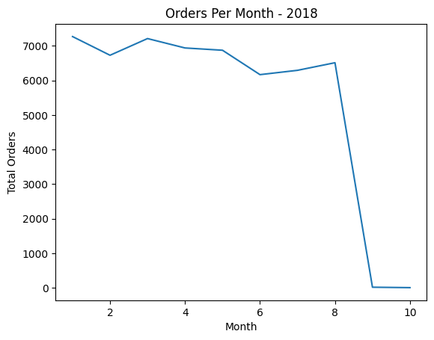
Monthly Orders Trend(2018)
Highest sales month: January
Secondary peak: March
Lowest active month: June
Overall Trend: Gradual decline from Q1 to mid-year, slight recovery in August
Sharp drop after August: Due to incomplete data for later months (not actual business fall)

Slide 6
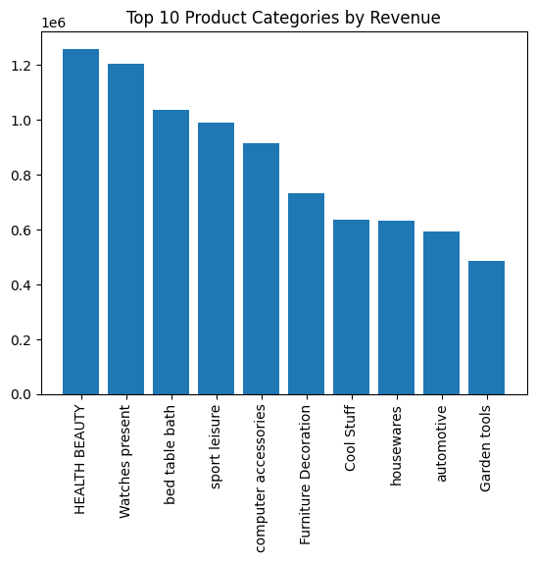
Revenue Contribution by Category
Health & Beauty is the highest revenue- generating category.
Followed by:
Watches & present
Bed Table Bath
Sports & Leisure
Top 5 categories contribute a major portion of total revenue.
Revenue is concentrated in limited categories (high category skew)

Slide 7
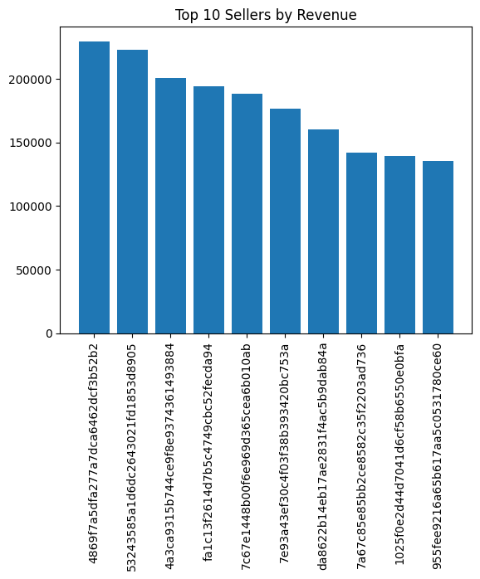
Seller Performance Analysis
Top seller generates approximately Rs200K+ revenue.
Significant revenue gap between top sellers and remaining sellers.
Revenue distribution is highly skewed toward a small group of sellers.
Seller ranking calculated using SQL window functions.

Slide 8
Growth Metrics ( Advanced Analytics)
Year-over-year sales show a consistent growth trend.
Cumulative monthly sales increase steadily each year, indicating expanding business volume
Customer retention within 6 months confirms repeat purchasing behavior.
Top 3 customers identified annually, highlighting the presence of high-value customers.
Moving average of order value shows a stable customer spending pattern.

Slide 9
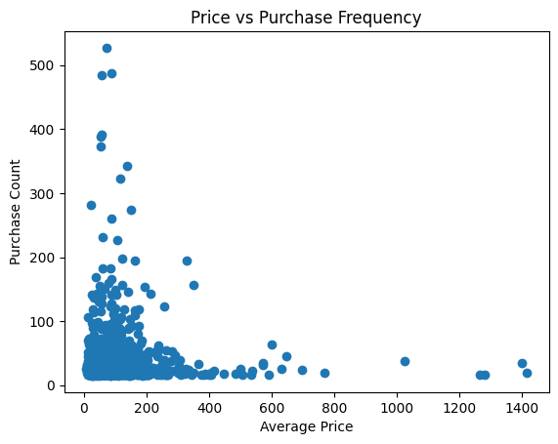
Price VS Demand (Correlation)
Price vs Purchase Correlation
Scatter plot created using Python to analyze the relationship between product price and purchase frequency.
Correlation coefficient: -0.028(very weak negative correlation)
Interpretation
Product price has almost no impact on purchase frequency.
Both high-priced and low-priced products show varied demand.
Customer purchasing behavior is influenced by factors beyond price(category, brand, need, etc.)

Slide 10
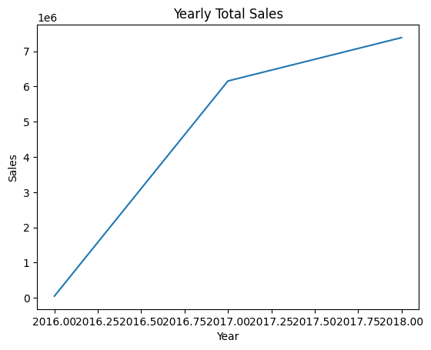
Yearly Sales Growth
Yearly Total Sales Trend
Strong revenue growth observed from 2016 to 2017.
Continued upward trend from 2017 to 2018.
Sales increased from near zero in 2016 to ~6.2M in 2017.
Reached approximately ~7.4M in 2018.

Slide 11
Key Business Insights
Revenue is heavily concentrated in a small number of product categories, indicating opportunity for category expansion.
Nearly half of all orders use installment payments, showing strong customer preference for flexible payment options.
Sales exhibit seasonal trends, with higher activity in early months of the year.
Customer retention within 6 months highlights repeat buying behavior and long-term growth potential.
Price alone does not strongly drive demand; purchasing decisions are influenced more by product category and customer needs.

Slide 12
Conclusion
Successfully built an end-to-end e-commerce analytics pipeline using MySQL and Python.
Extracted business KPIs using SQL joins, aggregations, and window functions.
Analyzed trends in customer behavior, revenue growth, seller performance, and retention.
Visualized insights using Python (Pandas & Matplotlib).
Project demonstrates real-world analytical workflow from raw data to business insights.

